Slide 1
INTRODUCTIONS
IN today's world, businesses are constantly looking for new ways to improve their customer service and engagement. One way to do this is by creating a chatbot that can quickly and accurately answer customer questions.
In this article, we will show you how to create a chatbot that is based on your own company documents.
There are a number of ways you could do this, In this article, you're going to explore some of them with their pros and cons, and we will be looking at fine-tuning GPT-3, direct prompt-engineering, and linking vector-index with GPT-3 API.

Slide 2
Building Our Chatbot using llama-index + ChatGPT API
Step 1: Prepare Your Company Documents
The first step is to gather all the documents that you want to use to create the chatbot. These documents can include product manuals, FAQs, and other helpful resources that your customers may need to reference. Once you have gathered your documents, you need to organize them into a folder called 'data' and save them in a format that can be easily read by Python.

Slide 3
$ pip install llama_index $ pip install langchain
$ pip install llama_index $ pip install langchain
$ pip install llama_index $ pip install langchain
$ pip install llama_index $ pip install langchain
Step 2: Installing and importing the Required Libraries
To build a chatbot, we need to use some Python libraries that are specifically designed for natural language processing and machine learning. In this code snippet, we are using the llama_index and langchain. You can install these libraries using pip:
Step 3: Set Up OpenAI API Key
To use the OpenAI language model, we need to set up our API key. You can get your own API key by signing up on the OpenAI website. Once you have your API key, replace 'YOUR_OPENAI_API_KEY' with your actual key in the following code line:

Slide 4
Step 4: Clean Your Chat Export
In this step, you’ll clean the WhatsApp chat export data so that you can use it as input to train
your chatbot on an industry-specific topic. In this example, the topic will be … houseplants!
Most data that you’ll use to train your chatbot will require some kind of cleaning before it can produce useful results. It’s just like the old saying goes:
Garbage in, garbage out (Source)
isTake some time tpotential o explore the data that you’re working with and to identify sues:

Slide 5
The article will cover the following steps
Setting up the Environment:
Installation of necessary dependencies for Python, including libraries and packages required for LangChain, data loaders, and OpenAI GPT-4.
Understanding LangChain Data Loaders:
Explaining the concept of data loaders in LangChain, which facilitate seamless integration of different data sources.
Demonstrating how to use data loaders to load and preprocess data for language model applications.
Leveraging Embeddings:
Introducing the concept of embeddings and their significance in understanding and processing text data.

Slide 6
CHATBOT DOCUMENTATIONS
while True:
user_input = input("Enter a query: ")
if user_input == "exit":
break
query = f"###Prompt {user_input}“
try:
llm_response = qa(query)
print(llm_response["result"])
except Exception as err:
print('Exception occurred. Please try again', str(err))

Slide 7
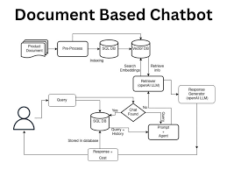

Slide 8
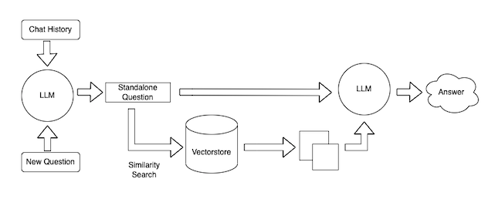

Slide 9
PHASE ONE
# training the chatbot
small_convo = [
'Hi there!',
'Hi',
'How do you do?',
'How are you?',
'I\'m cool.',
'Always cool.',
'I\'m Okay',
'Glad to hear that.',
'I\'m fine',
'I feel awesome',
'Excellent, glad to hear that.',
'Not so good',
'Sorry to hear that.',
'What\'s your name?',
' I\'m swetha. Ask me a math question please.
' ]
math_convo_1 = [
'Pythagorean theorem',
'a squared plus b squared equals c squared.' ]

Slide 10
math_convo_2
'Law of Cosines',
'c**2 = a**2 + b**2 - 2*a*b*cos(gamma)' ]
Output
# starting a conversation
>>> print(myBot.get_response("Hi, there!"))
Hi
>>> print(myBot.get_response("What's your name?"))
I'm Swetha. Ask me a math question, please. >>> print(myBot.get_response("Do you know Pythagorean theorem"))
a squared plus b squared equals c squared.
>>> print(myBot.get_response("Tell me the formula of law of cosines"))
c**2 = a**2 + b**2 - 2*a*b*cos(gamma)

Slide 11
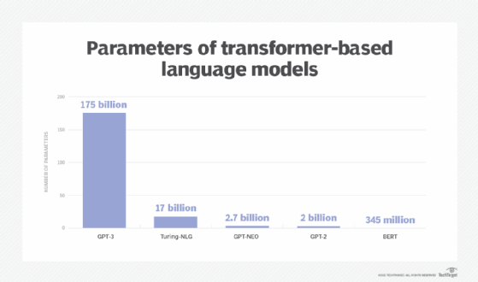
PRE-TRAINED LANFUAGE MODELS
GPT-3, or the third-generation
Generative Pre-trained Transformer,
is a neural network machine learning
model trained using internet data to
generate any type of text. Developed
by Open AI, it requires a small amount
of input text to generate large volumes
of relevant and sophisticated
machine-generated text.

Slide 12
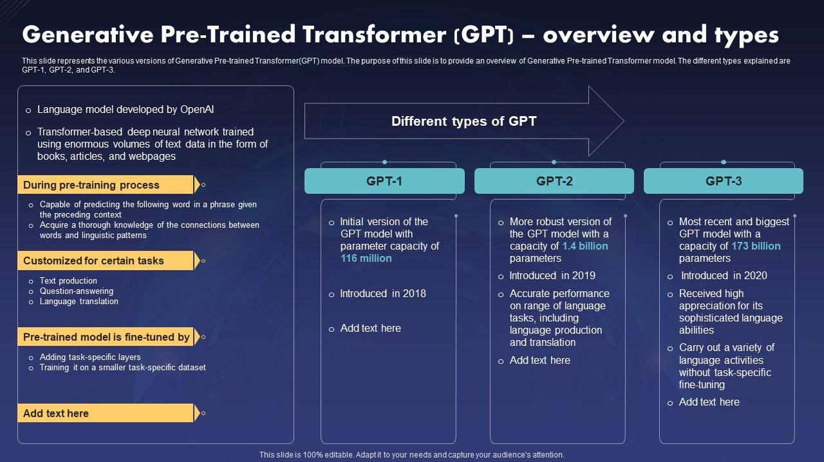
GPT PROTOCOL
GPT-3 is structurally similar to its predecessors,
its greater accuracy is attributed to its increased
capacity and greater number of parameters.
GPT-3's capacity is ten times larger than that
of Microsoft's Turing NLG, the next largest
NLP model known at the time.

Slide 13
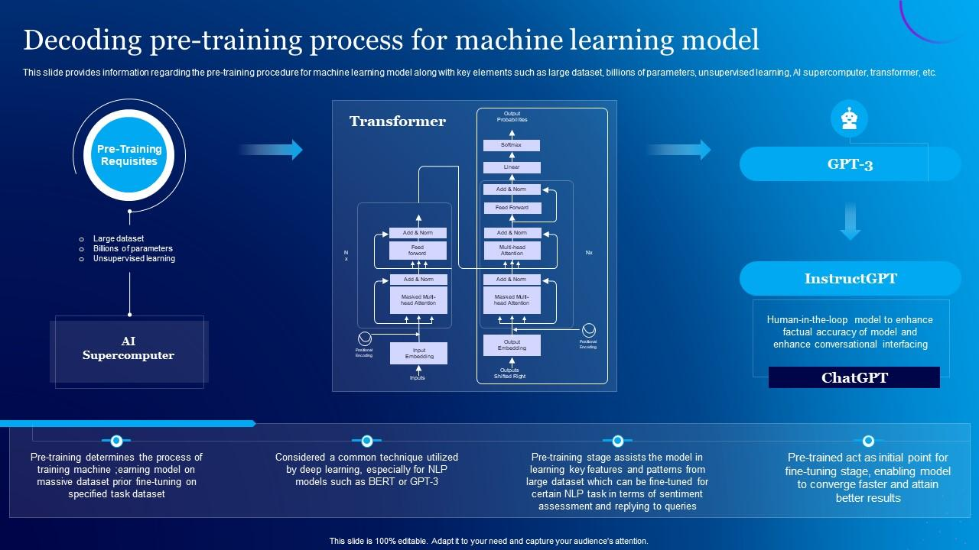
USER INTERFACE
Chat bots : GPT-3 can be integrated into chat bots to provide human-like conversational experiences for customer support, e-commerce, and other applications. Text classification: GPT-3 can be fine-tuned to classify text, so it can be used for spam detection or categorization of news articles.

Slide 14
PREPROCESSING THE DATASET
At the beginning of the chatbot development process, however, you may face the lack of training data, which results in low accuracy in intent classification. A few workarounds exist to solve this problem:
Pre-trained model
Training data generator
Crowdsource

Slide 15
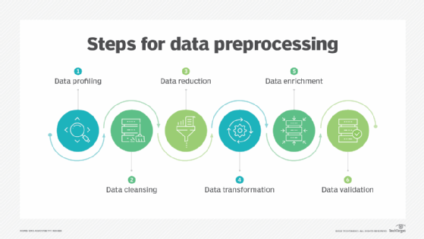
DATA PREPROCESSING
Data preprocessing transforms the data into a format that is more easily and effectively processed in data mining, machine learning and other data science tasks. The techniques are generally used at the earliest stages of the machine learning and AI development pipeline to ensure

Slide 16
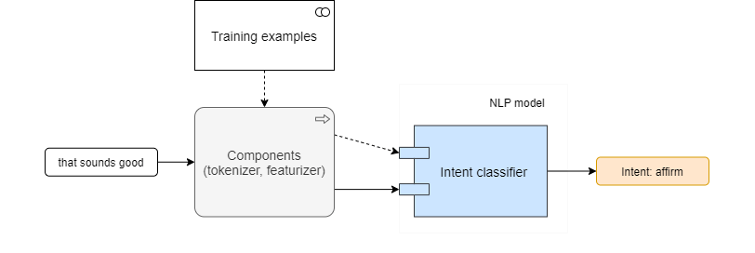
INITIAL MODEL

Slide 17
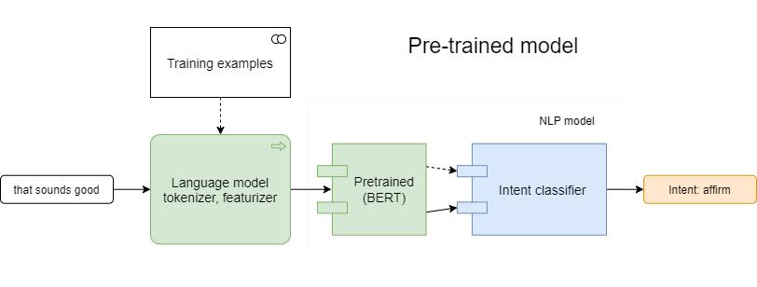
PRE- TRAINED MODEL

Slide 18
DEVELOPMENTS OF PART TWO
Typical chatbot architecture should consist of the following:
Chat window/session/front end application interface
The deep learning model for Natural Language Processing [NLP]
Corpus or training data for training the NLP model
Application Database for processing actions to be performed by the chatbot
Please refer to the below figure to understand the architectural interface:

Slide 19
FEATURE ENGINEERING
Feature engineering improves the performance of the machine learning model by selecting the right features for the model and preparing the features in a way that is suitable for the machine learning model. For example, if we would like to predict the price of a car, the target variable would be the Market Value.

Slide 20
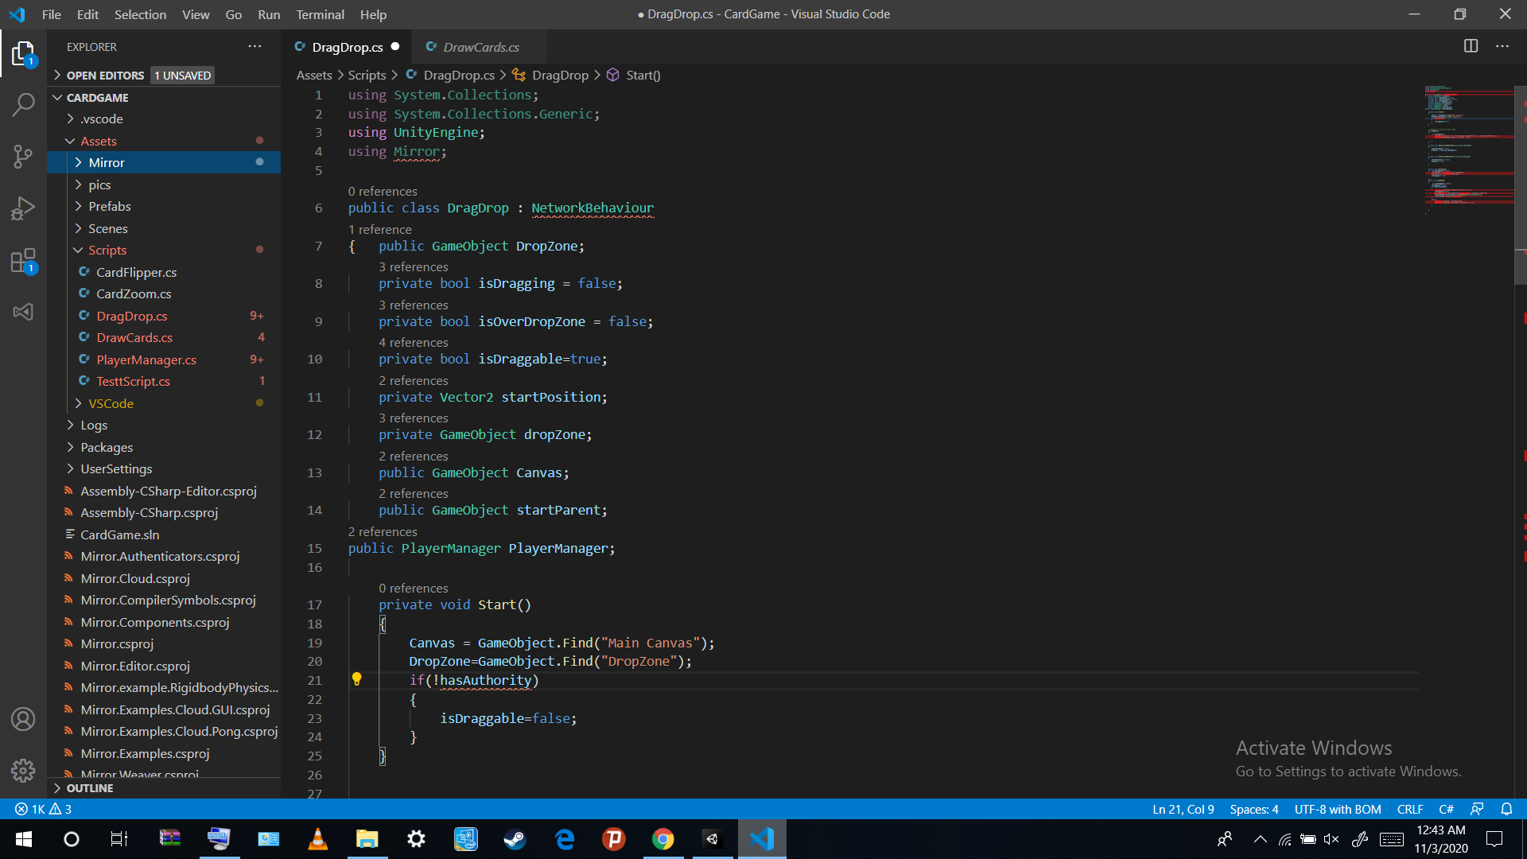

Slide 21
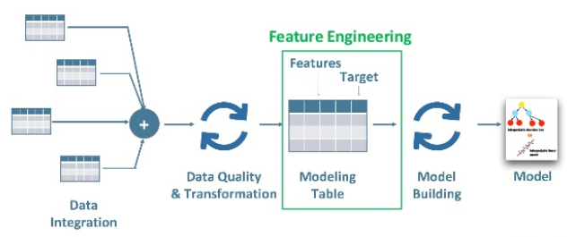

Slide 22
MODEL TRAINING
It is called Train/Test because you split the data set into two sets: a training set and a testing set. 80% for training, and 20% for testing. You train the model using the training set. You test the model using the testing set. Train the model means create the model.

Slide 23
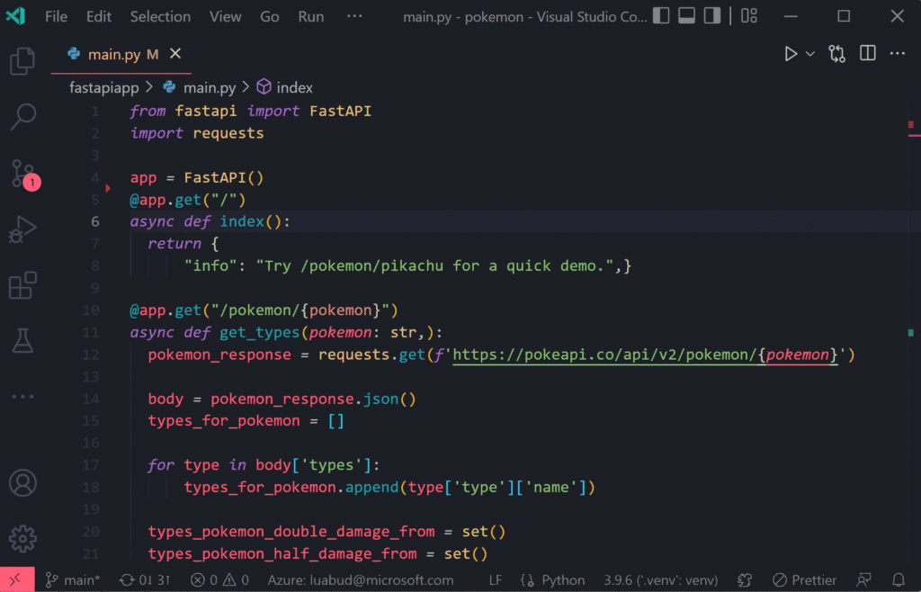

Slide 24
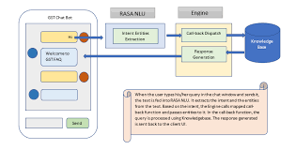

Slide 25
EVALUATIONS
Python's eval() allows you to evaluate arbitrary Python expressions from a string-based or compiled-code-based input. This function can be handy when you're trying to dynamically evaluate Python expressions from any input that comes as a string or a compiled code object.

Slide 26
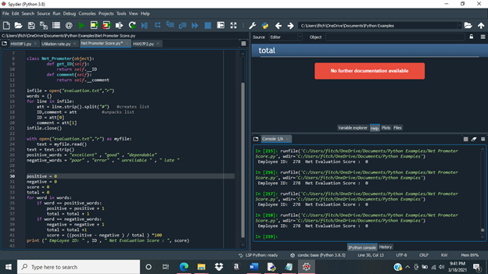

Slide 27
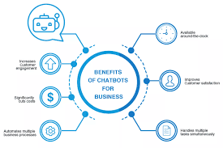

Slide 28
ADVANTAGE
Here are the benefits of chatbots for customers.
Provide fast, 24/7 customer service. ...
Offer more personalized experiences. ...
Deliver multilingual support. ...
Ensure more consistent support. ...
Offer convenient self-service options. ...
Provide proactive customer service. ...
Deliver omnichannel support. ...
Improve service with every interaction.

Slide 29
DISADVANTAGE
Cons of chatbots are as follows
Extent of Resolving Queries.
Cannot Handle Angry Customers Subtly.
Higher Complexity Results in Higher Costs.
Not Suitable for All Businesses and Applications.
Do not Provide Accurate Solutions Always.

Slide 30
CONCLUSIONS
In conclusion, LangChain provides a robust framework for developing language model-powered applications. By combining data-awareness, agentic capabilities, and integrations with powerful tools like OpenAI GPT-4, LangChain empowers developers to create intelligent systems that can chat with PDF documents. Through the use of data loaders, embeddings, and effective text splitting techniques, LangChain enables seamless integration and efficient processing of text data. With LangChain, the possibilities for creating innovative and interactive language model applications are endless. Embrace LangChain and revolutionize the way you interact with PDF documents using the power of language models.

